Slide 1
Project Introduction

Slide 2

Outline
Project Description
AES Encryption
Emulator 8086

Slide 3

Cryptography and Security
It is the study of encrypting and decrypting data to prevent unauthorized access. It is used to safeguard company secrets, secure classified information, and sensitive information from fraudulent activity, among other things.
Crypto means hidden and Graphy means writing

Slide 4
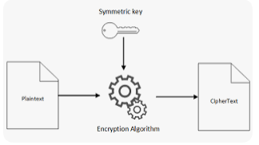
Encryption Algorithms
Encryption categories:
Symmetric Key Cryptography (Secret key)
Asymmetric Key Cryptography (Public key)
In secret key encryption, a single shared key is used to encrypt and decrypt the message
In public-key encryption, different two keys are used, both related to each other by a complex mathematical process.
Therefore, we can say that encryption and decryption take more time in public-key encryption.

Slide 5
Symmetric Key Cryptography
Advanced Encryption Standard (AES)
AES is a block cipher
The key size can be 128/192/256 bits
Encrypts data in blocks of 128 bits each
Note: AES performs operations on bytes of data rather than in bits. Since the block size is 128 bits, the cipher processes 128 bits (or 16 bytes) of the input data at a time.
The number of rounds depends on the key length as follows:
128 bit key – 10 rounds
192 bit key – 12 rounds
256 bit key – 14 rounds

Slide 6
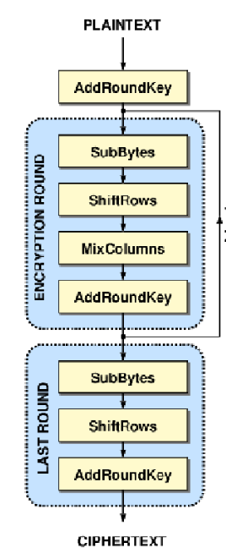
Advanced Encryption Standard
The encryption process will contain 10 rounds
All the rounds are identical except last round
Rounds consists of:
Sub Bytes
Shift Rows
Mix Columns
Add Round Key

Slide 7
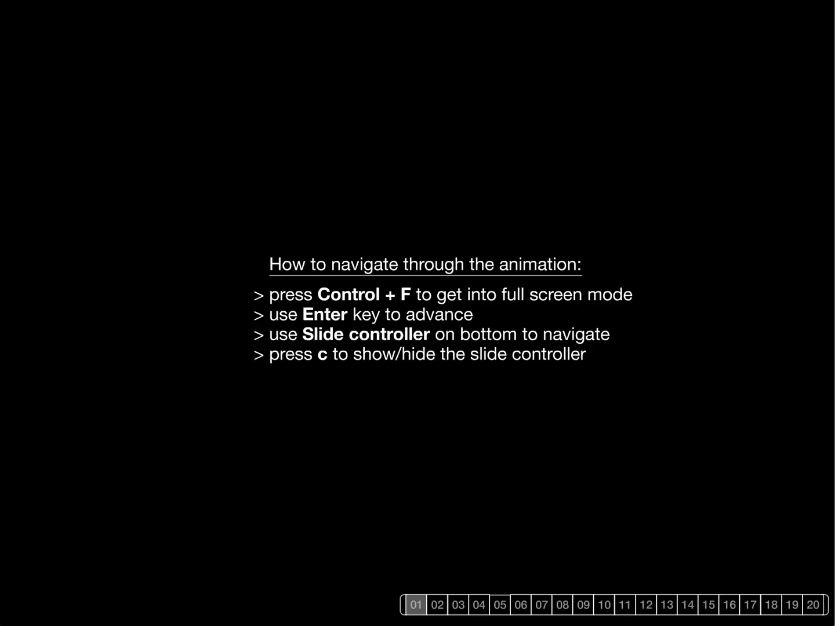
AES

Slide 8
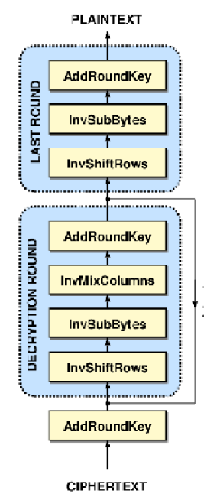
Advanced Decryption Standard
The decryption process will contain 10 rounds
Same key is used in both operations
Rounds consists of:
Inverse Sub Bytes
Inverse Shift Rows
Inverse Mix Columns
Add Round Key

